Slide 1
BST INSERTION AND DELETION

Slide 2
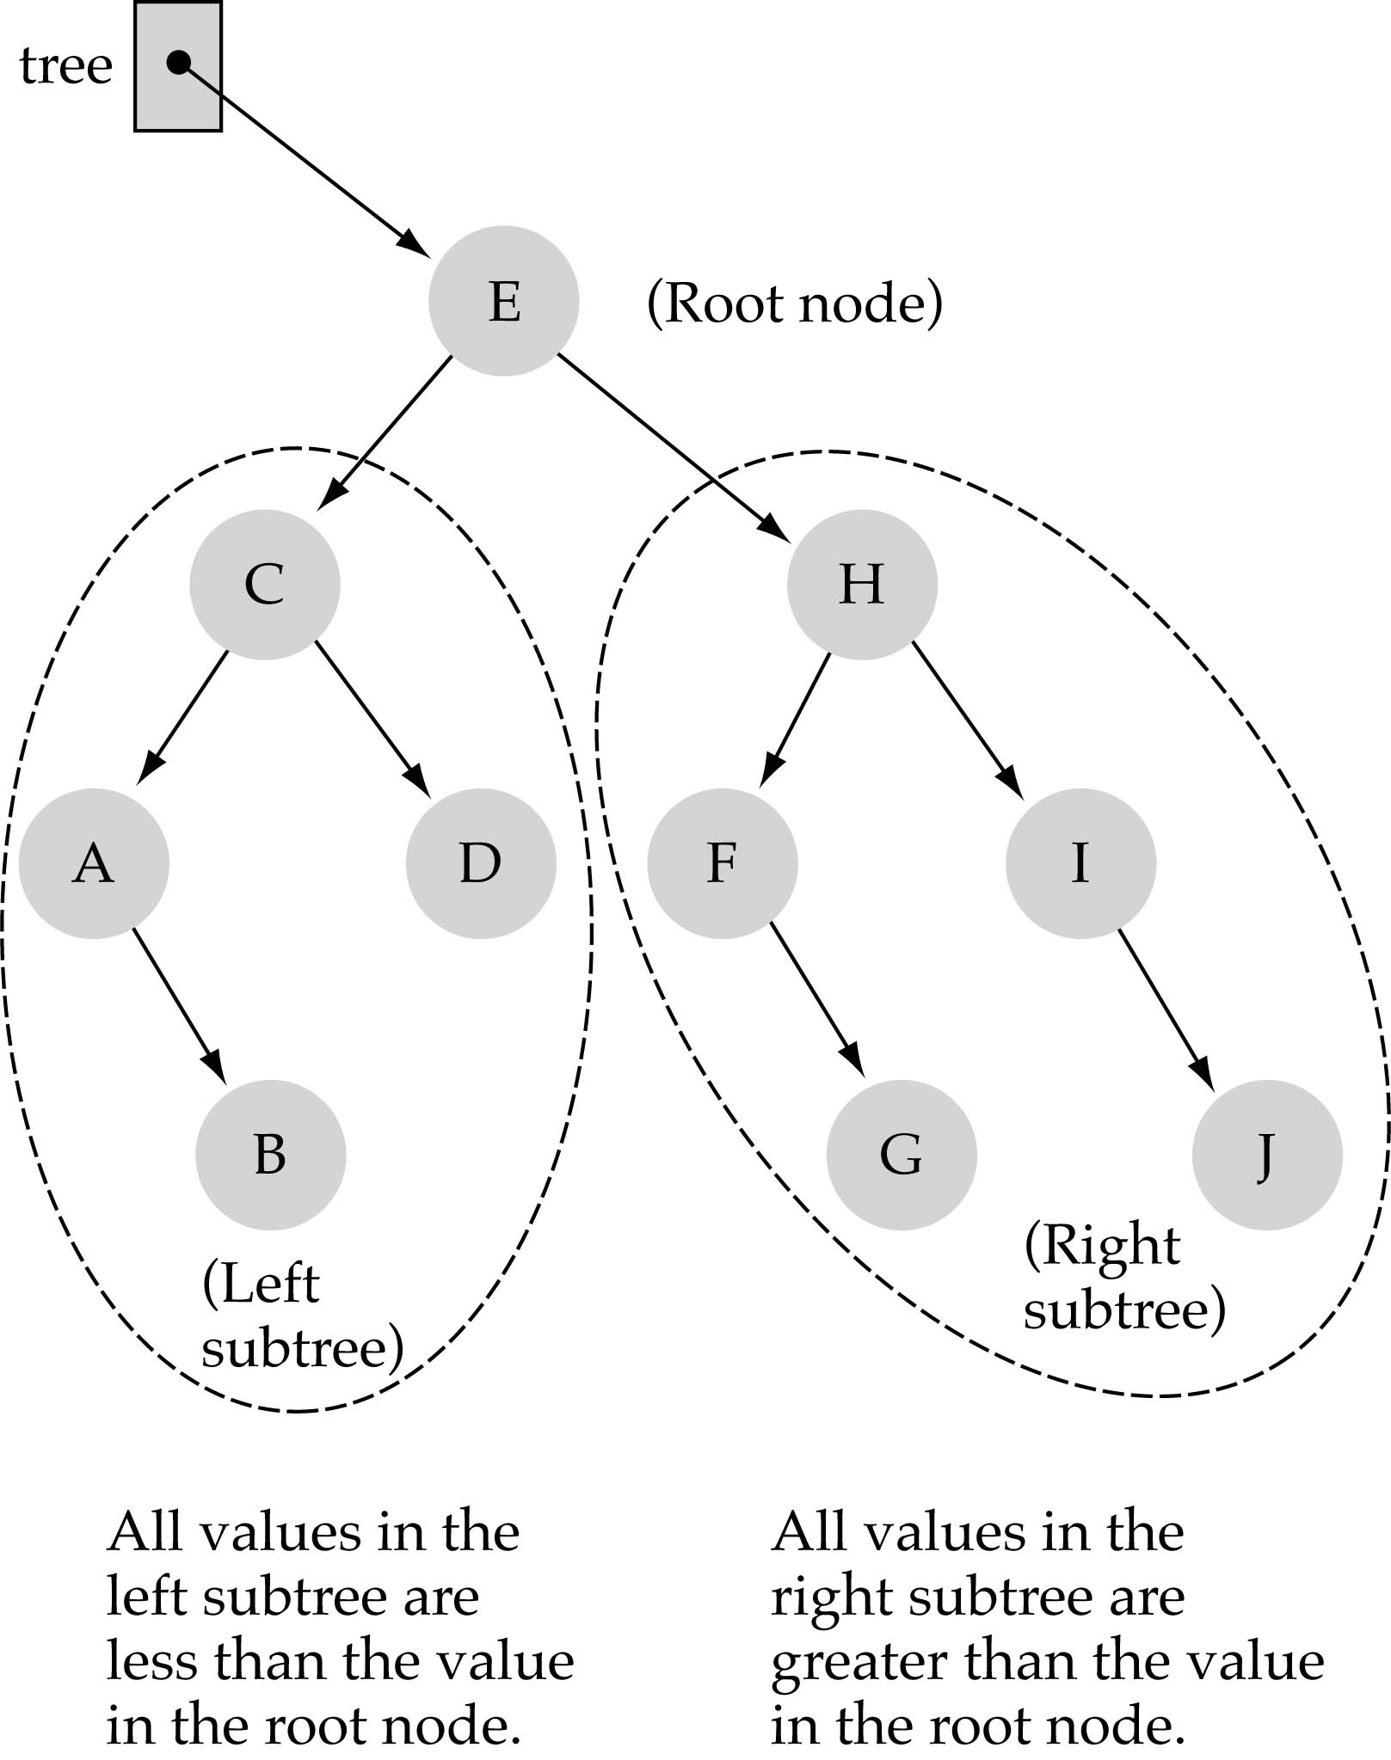
Binary Search Trees (BSTs)
Binary Search Tree Property:
The value stored at
a node is greater than
the value stored at its
left child and less than
the value stored at its
right child

Slide 3
Binary Search Trees (BSTs)
In a BST, the value stored at the root of a subtree is greater than any value in its left subtree and less than any value in its right subtree!

Slide 4
Binary Search Trees (BSTs)
Where is the smallest element?
Ans: leftmost element
Where is the largest element?
Ans: rightmost element

Slide 5
How to search a binary search tree?
(1) Start at the root
(2) Compare the value of the item you are searching for with the value stored at the root
(3) If the values are equal, then item found; otherwise, if it is a leaf node, then not found

Slide 6
How to search a binary search tree?
(4) If it is less than the value stored at the root, then search the left subtree
(5) If it is greater than the value stored at the root, then search the right subtree
(6) Repeat steps 2-6 for the root of the subtree chosen in the previous step 4 or 5

Slide 7
How to search a binary search tree?
Is this better than searching
a linked list?
Yes !! ---> O(logN)

Slide 8
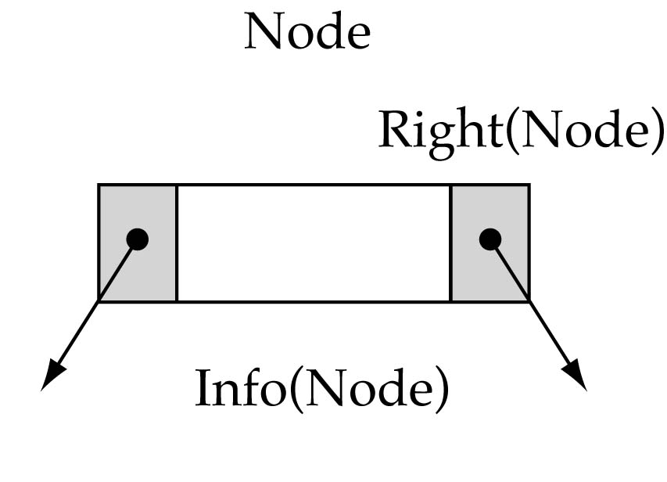
Tree node structure
struct TreeNode {
ItemType info;
struct TreeNode* left;
struct TreeNode* right;
};

Slide 9
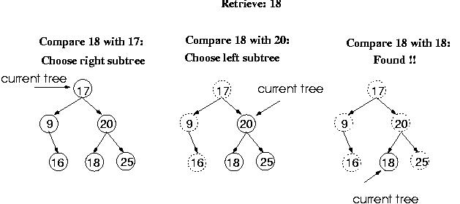
Function Retrieve Item

Slide 10
Function Retrieve Item
What is the size of the problem?
  Number of nodes in the tree we are examining
What is the base case(s)?
    When the key is found
    The tree is empty (key was not found)
What is the general case?
  Search in the left or right subtrees

Slide 11
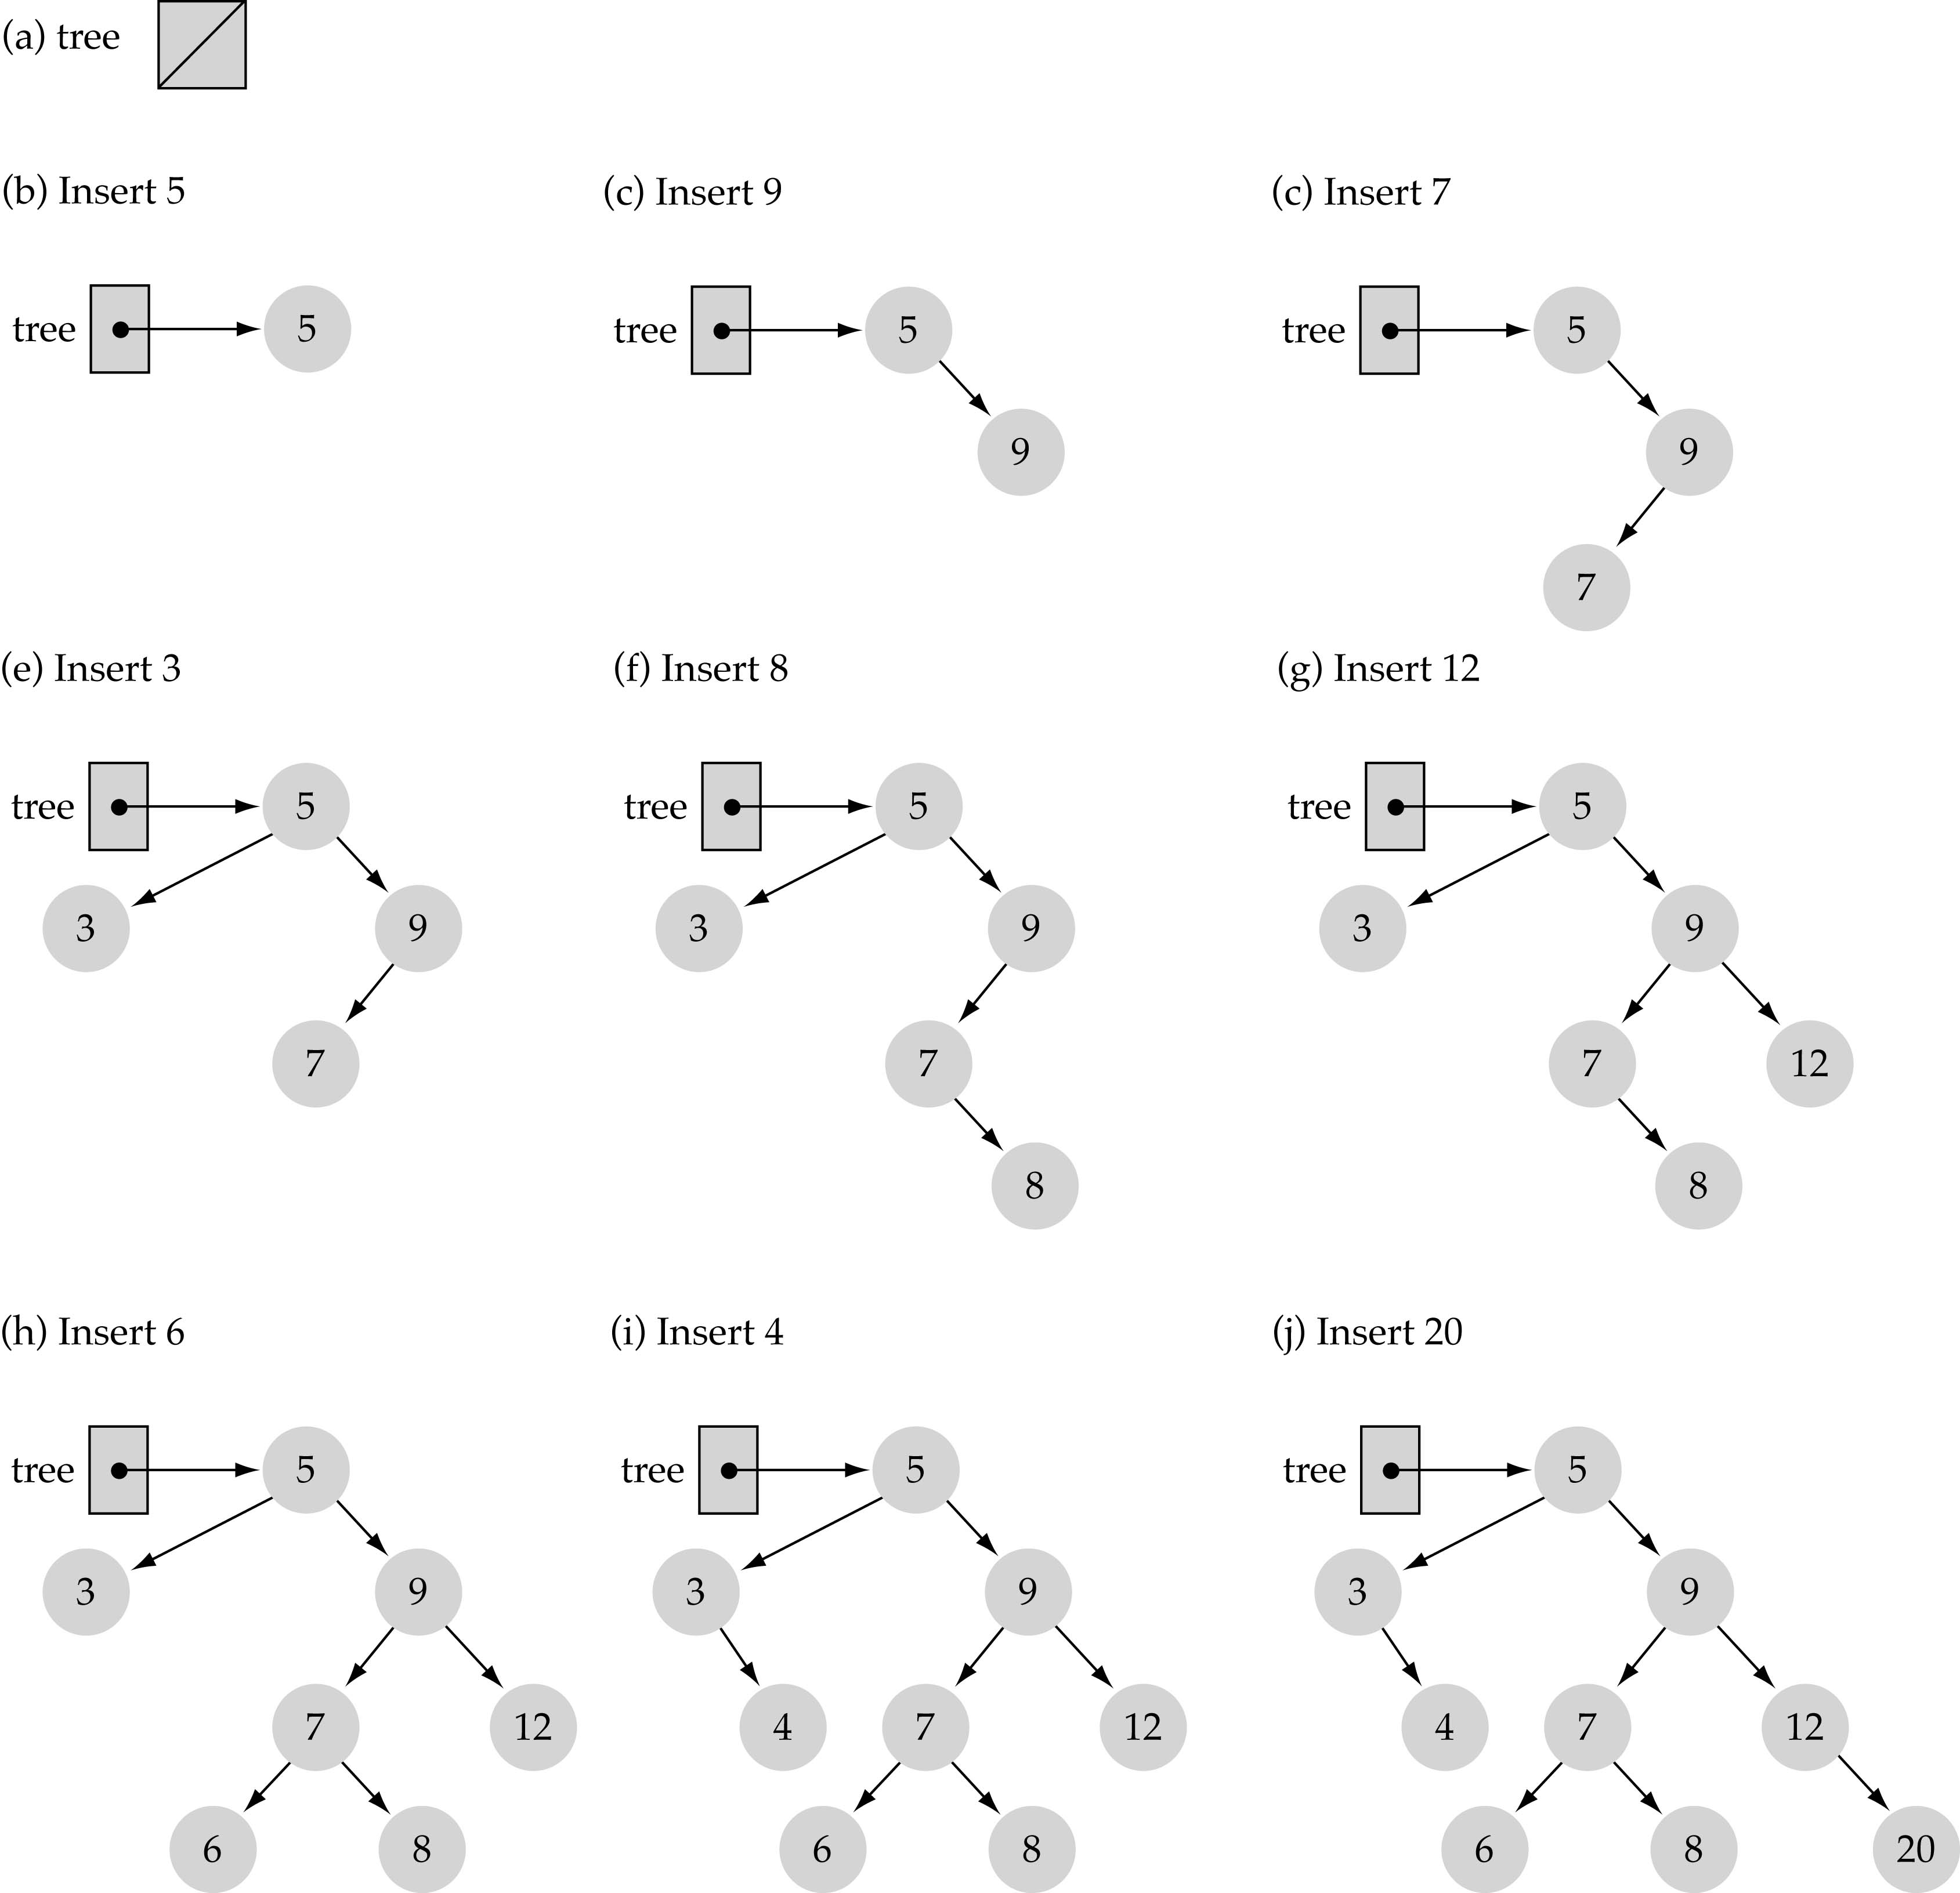
Function Insert Item
Use the binary search tree property to insert the new item at the correct place

Slide 12
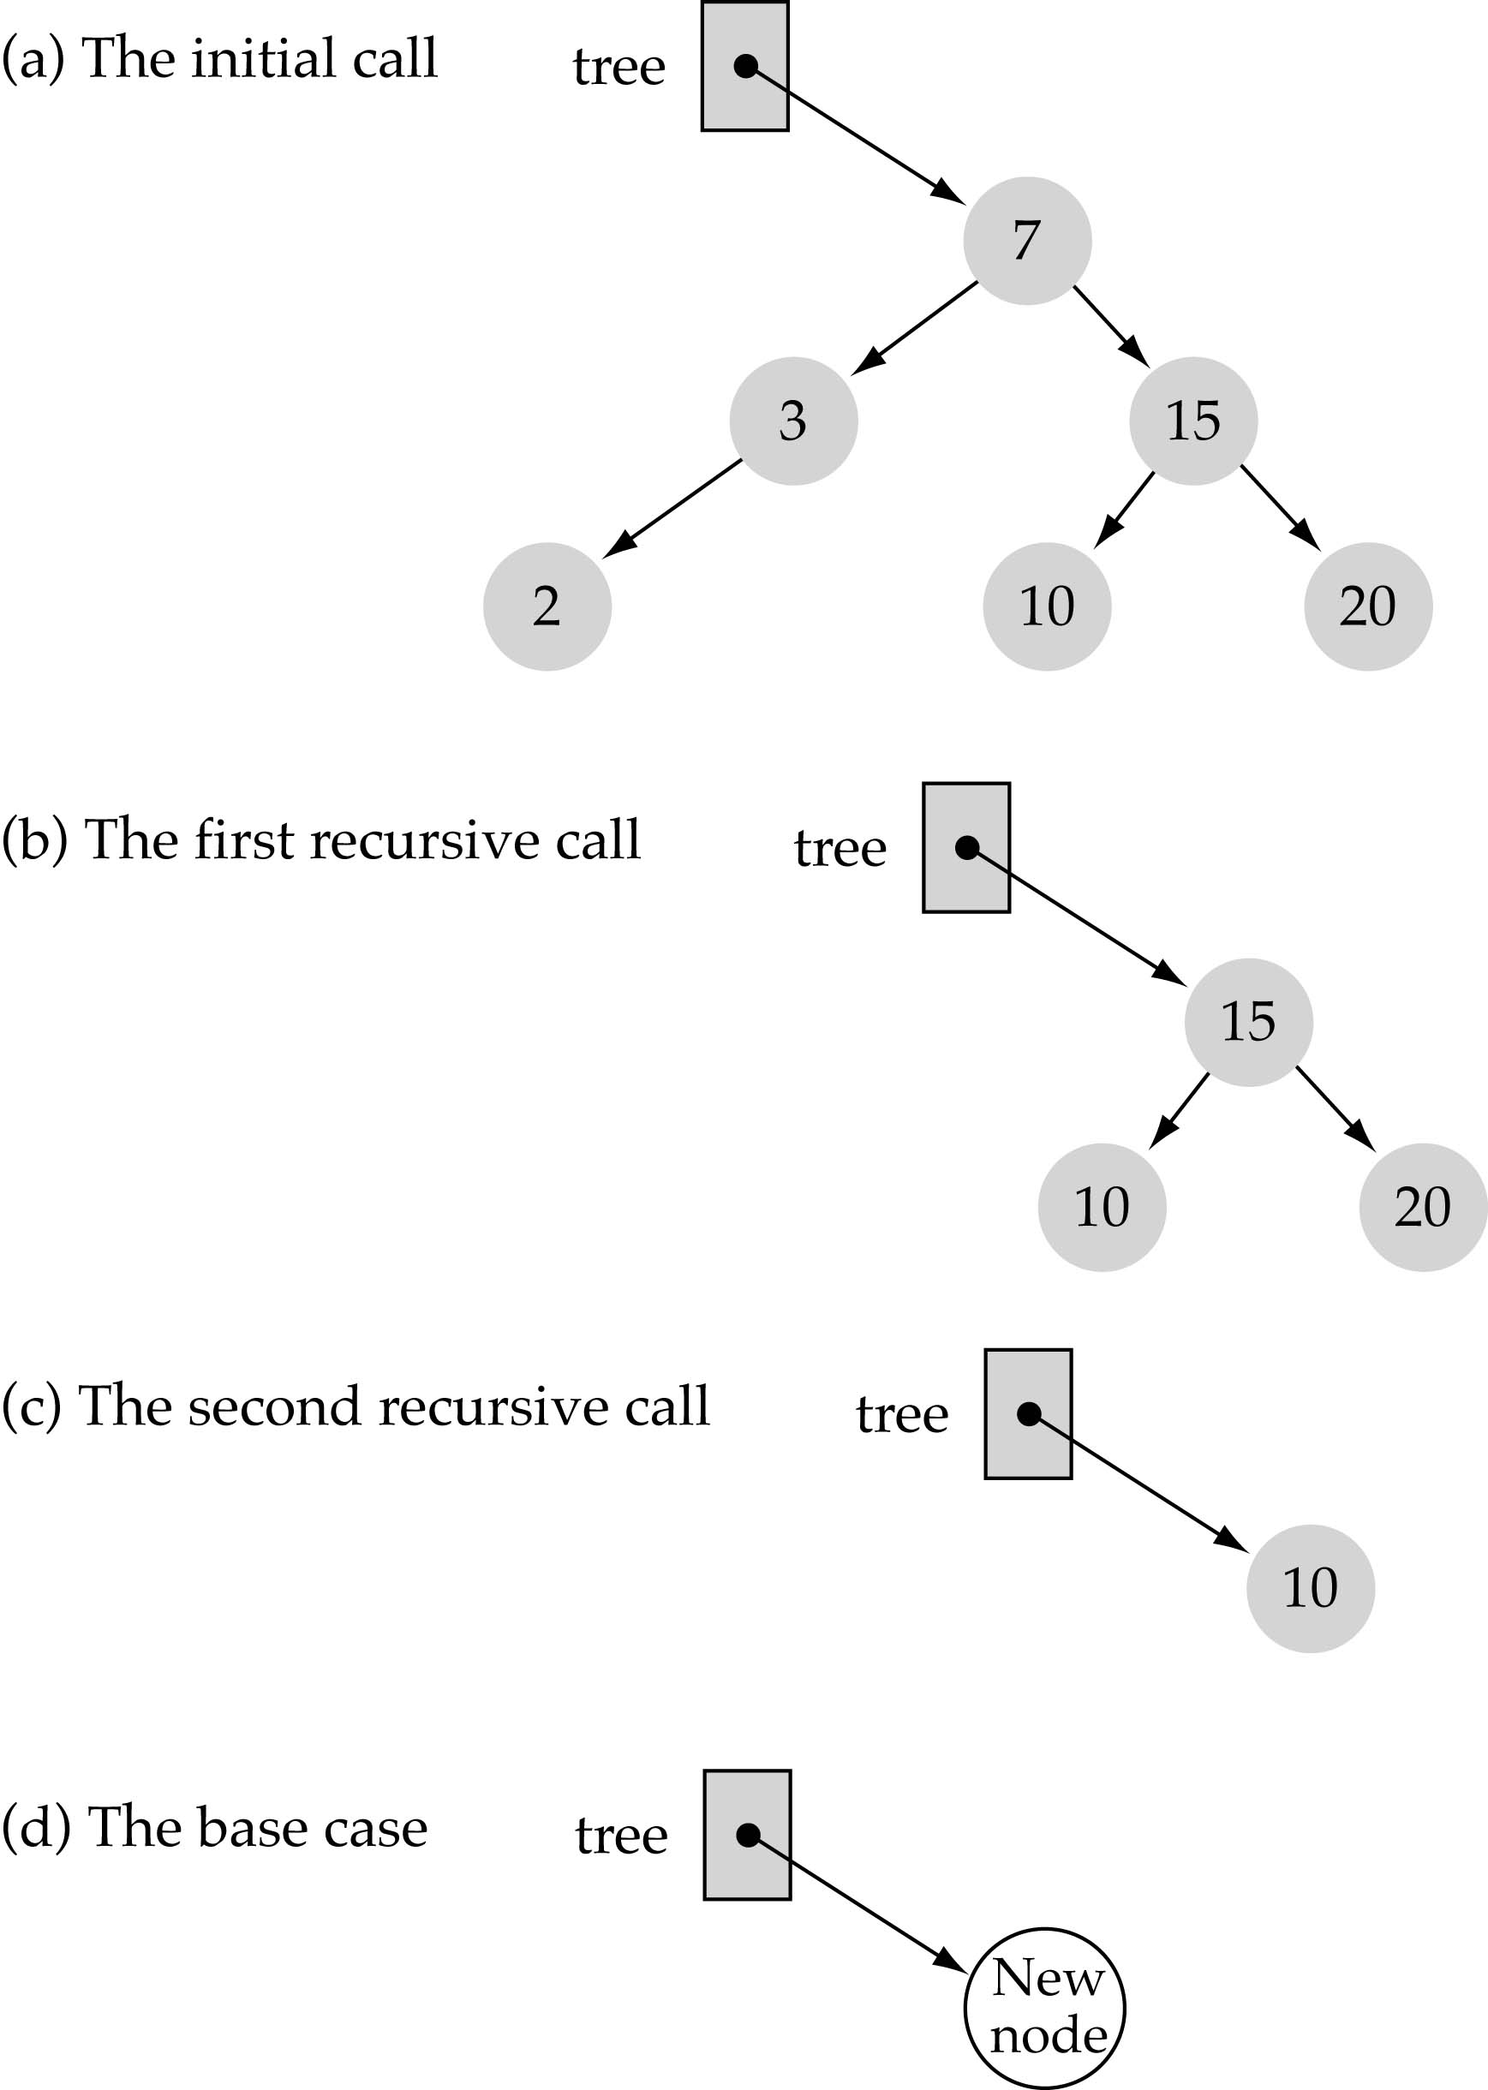
Function Insert Item
(cont.)
Implementing insertion resursively
e.g., insert 11

Slide 13
Construct Binary Search tree using the following numbers
45, 56, 32, 14, 27, 18, 12, 50, 66, 49, 61, 7, 10, 76

Slide 14
Does the order of inserting elements into a tree matter?
Yes, certain orders might produce very unbalanced trees!

Slide 15
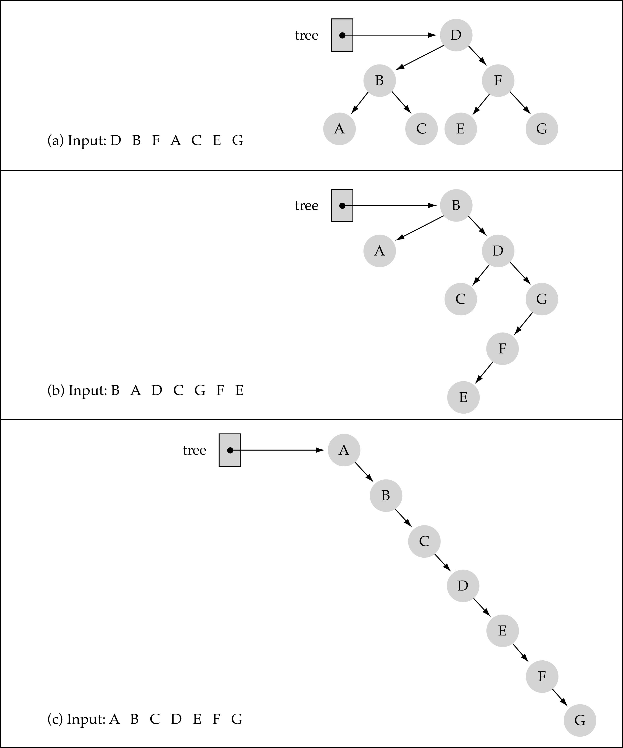
Does the order of inserting elements into a tree matter?
(cont.)

Slide 16
Does the order of inserting elements into a tree matter? (cont’d)
Unbalanced trees are not desirable because search time increases!
Advanced tree structures, such as red-black trees, guarantee balanced trees.

Slide 17
INSERT ALGORITHM
If node == NULL
return createNode(data)
if (data < node->data)
node->left = insert(node->left, data);
else if (data > node->data)
node->right = insert(node->right, data);
return node;

Slide 18
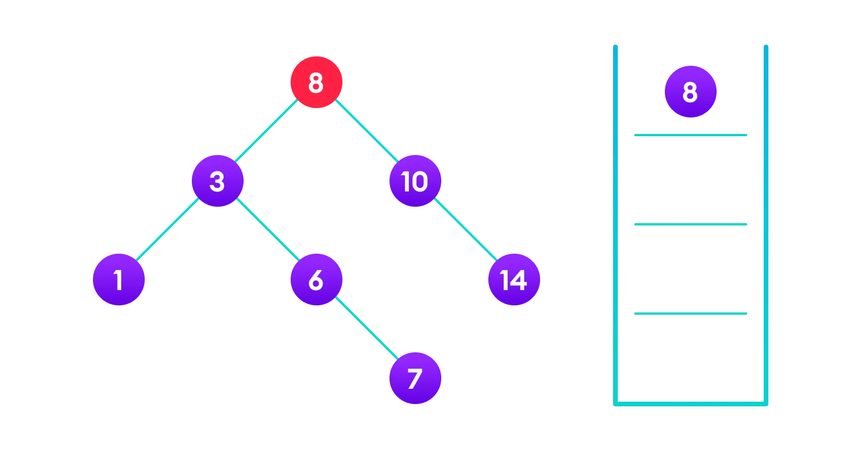
INSERT 4

Slide 19
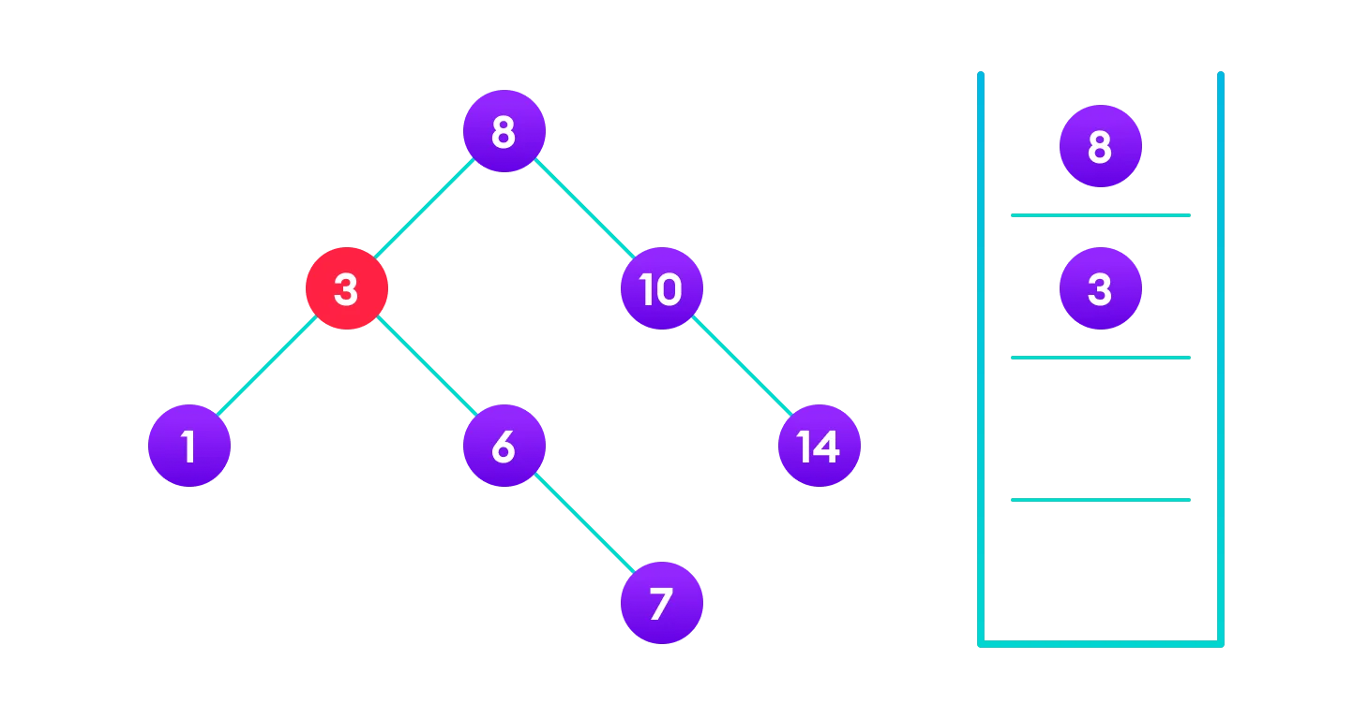

Slide 20
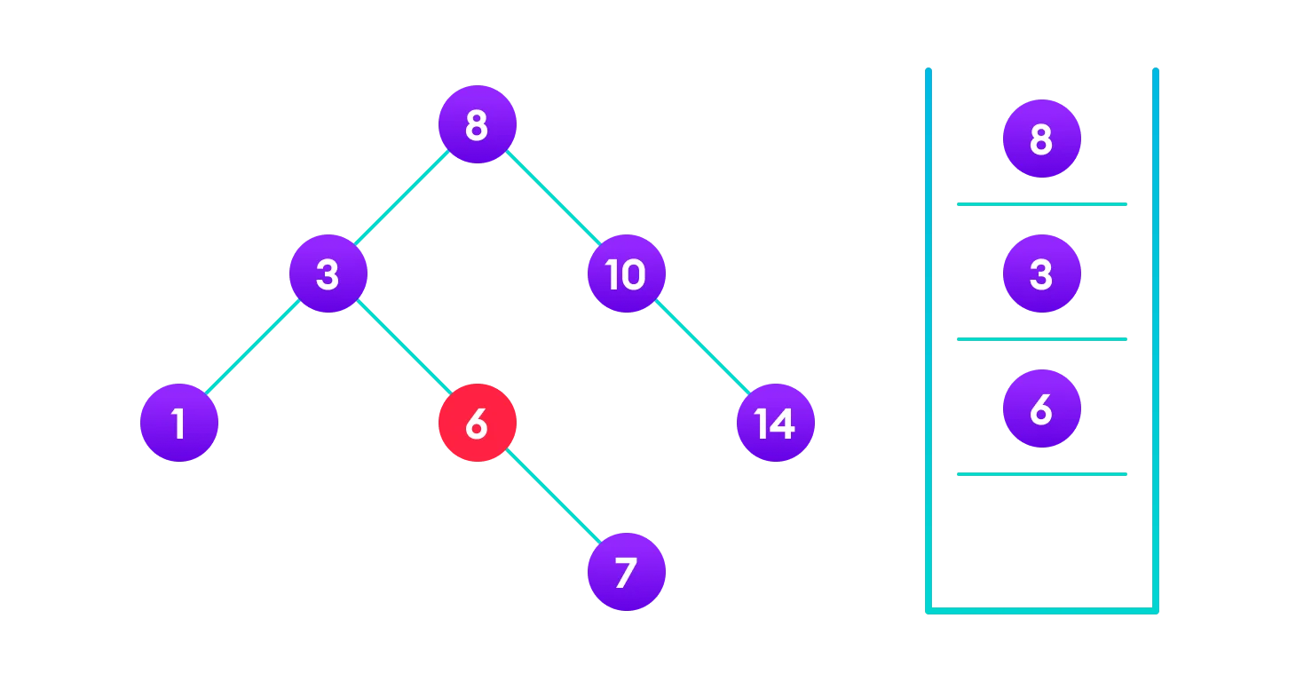

Slide 21
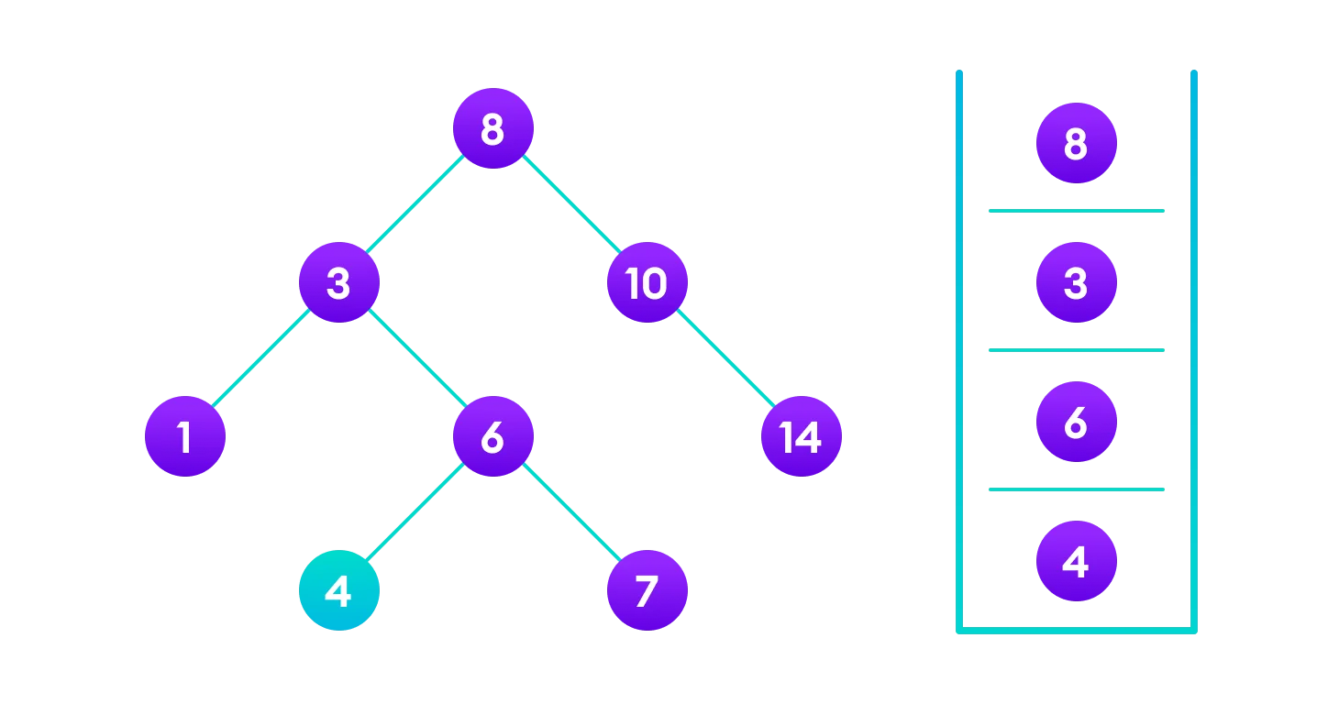

Slide 22
Function DeleteItem
First, find the item; then, delete it
Binary search tree property must be preserved!!
We need to consider three different cases:
(1) Deleting a leaf
(2) Deleting a node with only one child
(3) Deleting a node with two children

Slide 23
DELETION
Deletion Operation
There are three cases for deleting a node from a binary search tree.
Case I
In the first case, the node to be deleted is the leaf node. In such a case, simply delete the node from the tree.

Slide 24
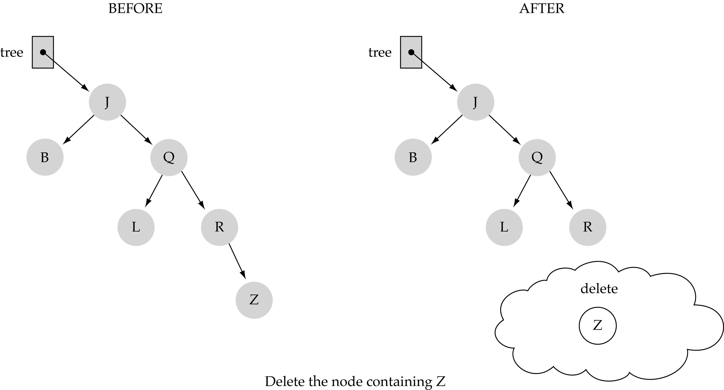
(1) Deleting a leaf

Slide 25
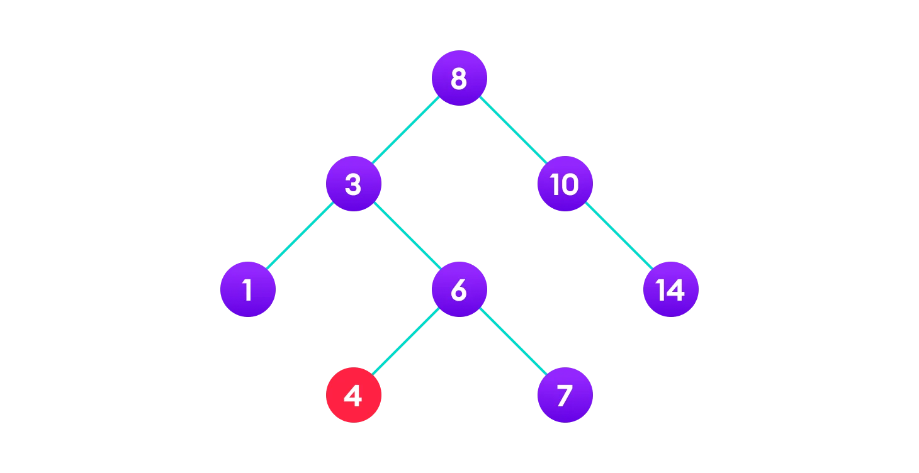
DELETE NODE 4

Slide 26
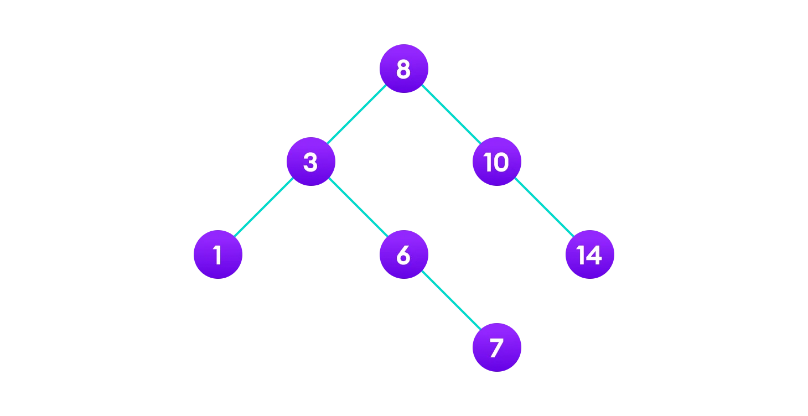

Slide 27
Case II
In the second case, the node to be deleted lies has a single child node. In such a case follow the steps below:
Replace that node with its child node.
Remove the child node from its original position.

Slide 28
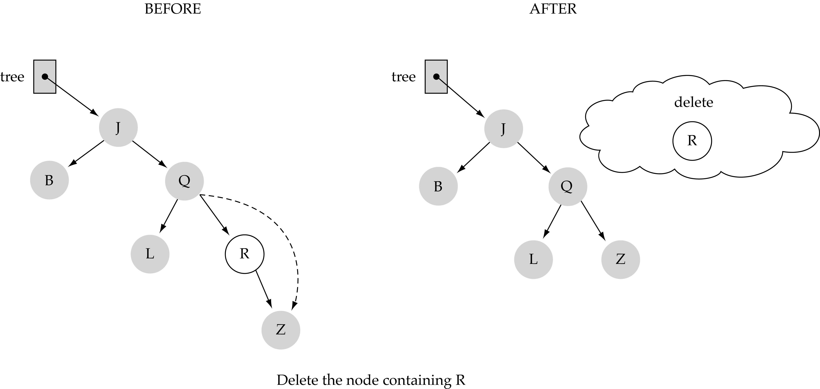
(2) Deleting a node with only one child

Slide 29
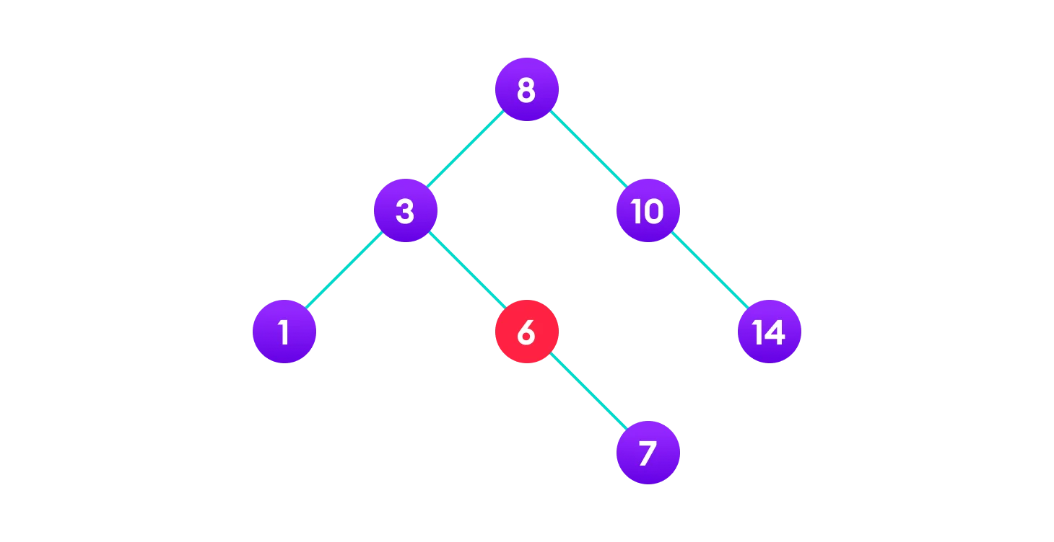
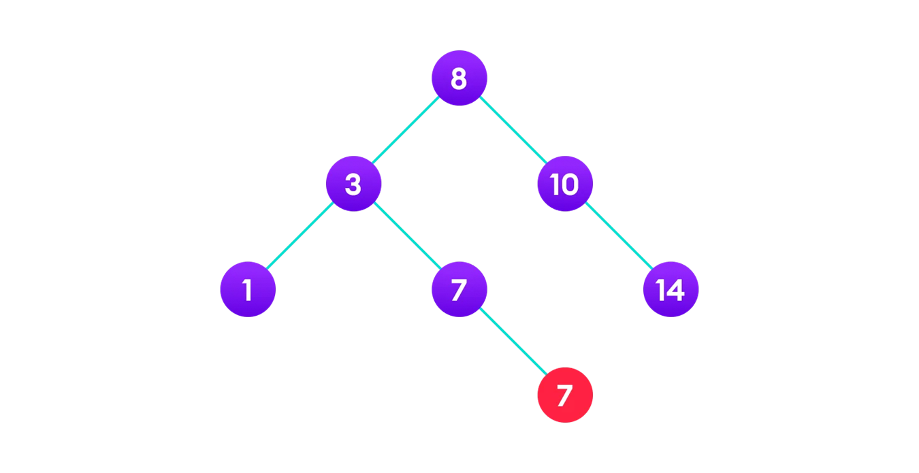
DELETE NODE 6

Slide 30
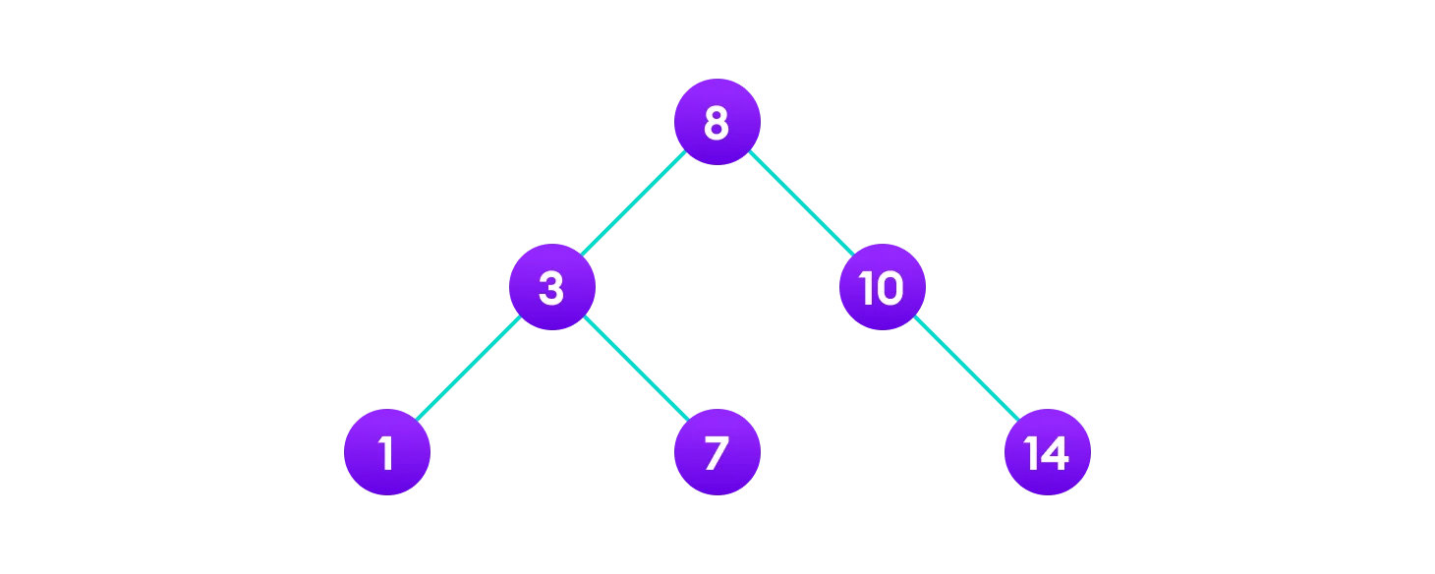

Slide 31
Case III
In the third case, the node to be deleted has two children. In such a case follow the steps below:
Get the inorder successor of that node.
Replace the node with the inorder successor.
Remove the inorder successor from its original position.

Slide 32
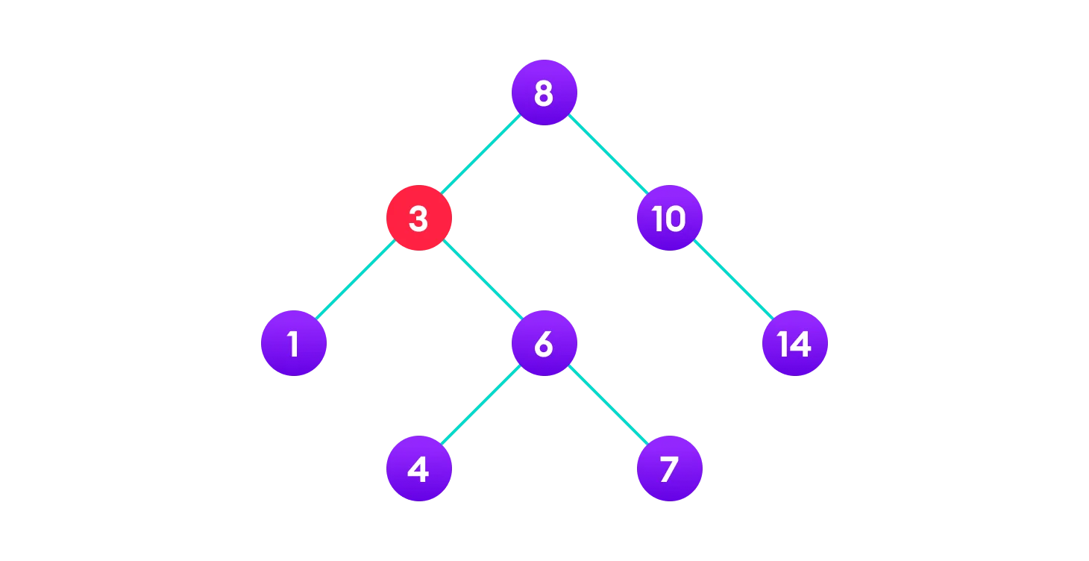

Slide 33

Copy the value of the inorder successor (4) to the node
Delete the inorder successor

Slide 34
(3) Deleting a node with two children (cont.)
Find predecessor (i.e., rightmost node in the left subtree)
Replace the data of the node to be deleted with predecessor's data
Delete predecessor node

Slide 35
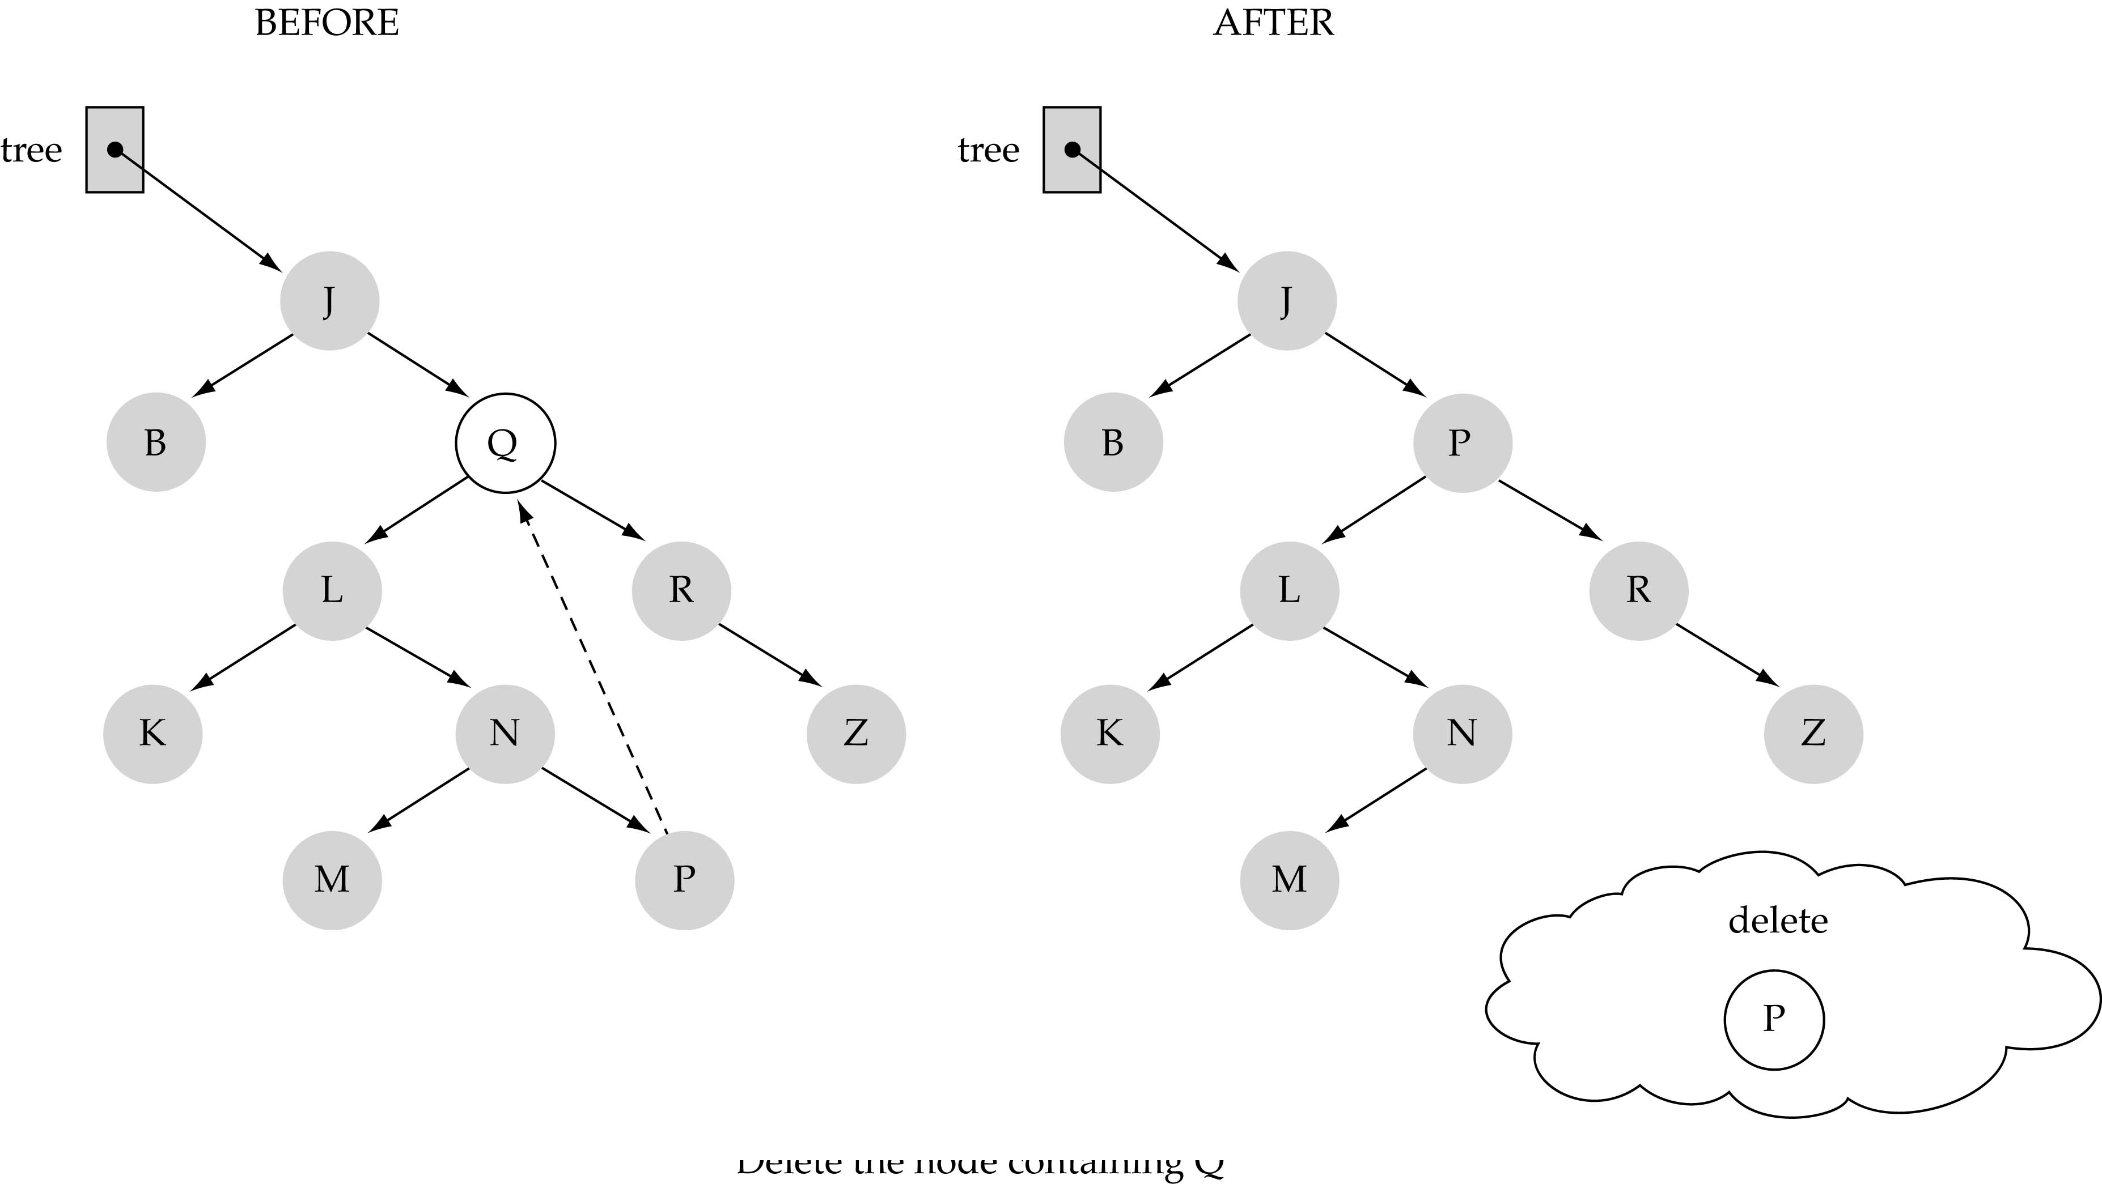
(3) Deleting a node with two children

Slide 36
Function DeleteItem (cont.)
What is the size of the problem?
  Number of nodes in the tree we are examining
What is the base case(s)?
  Key to be deleted was found
What is the general case?
  Choose the left or right subtree

Slide 37
Construct a Binary tree using the given numbers and perform the following deletion operation
45, 56, 32, 14, 27, 18, 12, 50, 66, 49, 61, 7, 10, 76
Delete 10
Delete 50
Delete 14

Slide 38
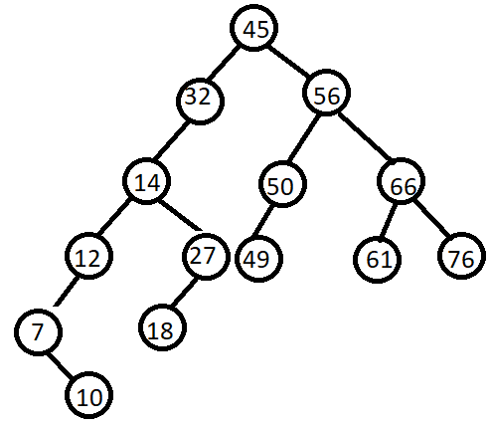

Slide 39
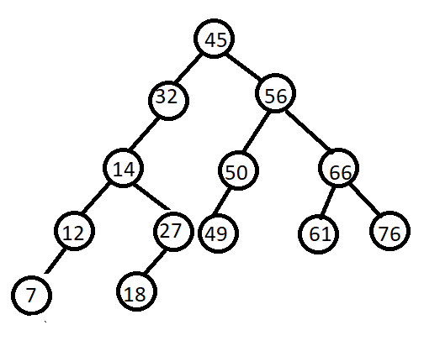
After the Node 10 is deleted

Slide 40
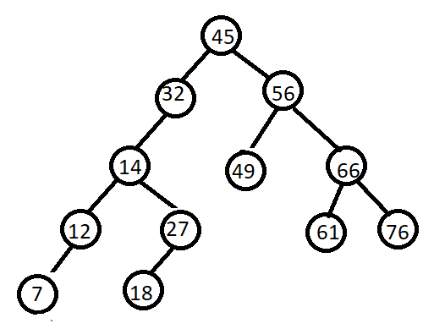
After the Node 50 is deleted

Slide 41
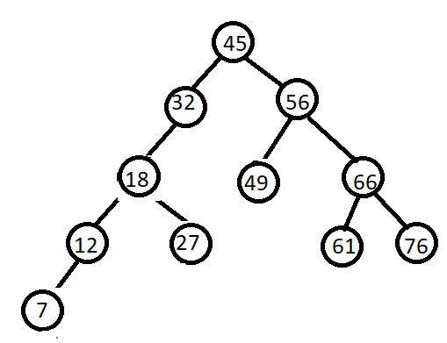
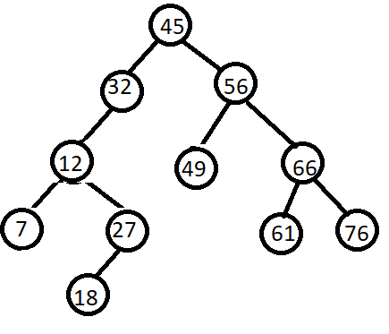
After the Node 14 is deleted
Predecessor 12 is replaced
Successor 18 is replaced

Slide 42
Time Complexity: The worst case time complexity of delete operation is O(h) where h is height of Binary Search Tree. In worst case, we may have to travel from root to the deepest leaf node. The height of a skewed tree may become n and the time complexity of delete operation may become O(n)

Slide 43
Comparing Binary Search Trees to Linear Lists
Big-O Comparison
Operation | Binary Search Tree | Array-based List | Linked List
Constructor | O(1) | O(1) | O(1)
Destructor | O(N) | O(1) | O(N)
IsFull | O(1) | O(1) | O(1)
IsEmpty | O(1) | O(1) | O(1)
RetrieveItem | O(logN^{)*} | O(logN) | O(N)
InsertItem | O(logN^{)*} | O(N) | O(N)
DeleteItem | O(logN)* | O(N) | O(N)
*assuming h=O(logN)

Slide 44
Finding the Minimum and Maximum
In the Binary Search Tree the minimum is the left most element and the maximum is the right most element

Slide 45
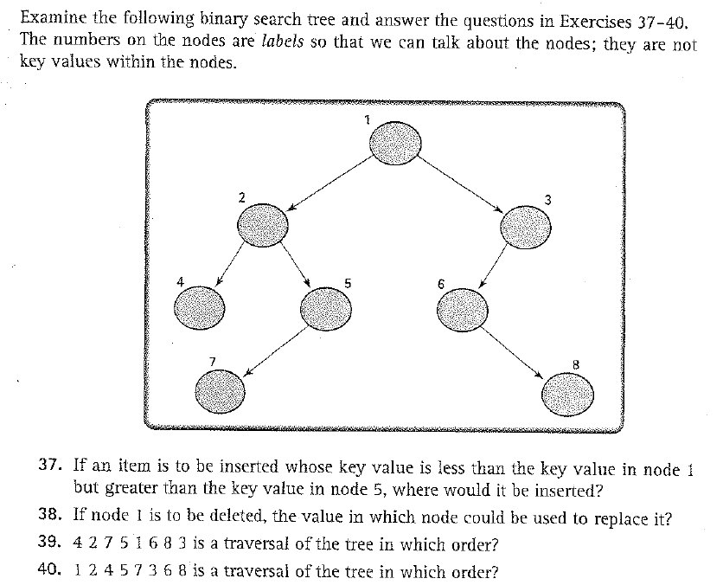
Exercises 37-41 (p. 539)

Slide 46
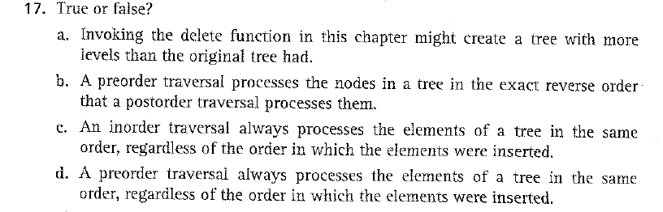
Exercise 17 (p. 537)

Slide 47

Exercise 18 (p. 537)

Slide 48
// Binary Search Tree operations in C
#include <stdio.h>
#include <stdlib.h>
struct node {
int key;
struct node *left, *right;
};
// Create a node
struct node *newNode(int item) {
struct node *temp = (struct node *)malloc(sizeof(struct node));
temp->key = item;
temp->left = temp->right = NULL;
return temp;
}
// Inorder Traversal
void inorder(struct node *root) {
if (root != NULL) {
// Traverse left
inorder(root->left);
// Traverse root
printf("%d -> ", root->key);
// Traverse right
inorder(root->right);
}
}

Slide 49
// Insert a node
struct node *insert
(struct node *node, int key) {
// Return a new node if the tree is empty
if (node == NULL) return newNode(key);
// Traverse to the right place and insert the node
if (key < node->key)
node->left = insert(node->left, key);
else
node->right = insert(node->right, key);
return node;
}
/ Find the inorder successor
struct node *minValueNode (struct node *node)
{
struct node *current = node;
// Find the leftmost leaf
while (current && current->left != NULL)
current = current->left;
return current;
}

Slide 50
// Deleting a node
struct node *delNode(struct node *root, int key)
{ // Return if the tree is empty
if (root == NULL) return root;
// Find the node to be deleted
if (key < root->key)
root->left = delNode(root->left, key);
else if (key > root->key)
root->right = delNode(root->right,key);
else
{ // If the node is with only one child or no child
if (root->left == NULL) {
struct node *temp = root->right;
free(root);
return temp;
}
else if (root->right == NULL) {
struct node *temp = root->left;
free(root);
return temp;
}
// If the node has two children
struct node *temp = minValueNode(root->right);
// Place the inorder successor in position of the node to be deleted
root->key = temp->key;
// Delete the inorder successor
root->right=delNode
(root->right,temp-> key );
}
return root;
}

Slide 51
// Driver code
int main() {
struct node *root = NULL;
root = insert(root, 8);
root = insert(root, 3);
root = insert(root, 1);
root = insert(root, 6);
root = insert(root, 7);
root = insert(root, 10);
root = insert(root, 14);
root = insert(root, 4);
printf("Inorder traversal: ");
inorder(root);
printf("\nAfter deleting 10\n");
root = deleteNode(root, 10);
printf("Inorder traversal: ");
inorder(root);
}

